Slide 1

Dismantling the Racism Machine:
Week 4 a lecture series sponsored by the Summit Free Public Library
Dr. Karen Gaffney
English Department
Raritan Valley Community College
Branchburg, NJ
Website: dividednolonger.com
Email: dividednolonger@gmail.com
Twitter: @dividednolonger
Pronouns: she/her/hers

Slide 2
Lecture Series Schedule
Fridays July 17 - August 7 myths taught to white people that need to be debunked in order to challenge systemic racism
Week 1 - What does it mean to say that race is a social construct and not biological, and why does it matter?
  Myth #1: Human races are biologically different (or, race is biological)
Week 2 - How did the invention of race serve to divide and conquer people in colonial America, and what impact does this continue to have?
  Myth #2: Race has always existed. Whiteness has always existed.
Week 3 - How and why has systemic racism persisted after the civil rights movement?
  Myth #3: Myth: Racism occurred in the past, but that problem has been resolved. (Or, the Civil Rights Movement ended racism)
Week 4 - How can white people best challenge systemic racism today?

Slide 3
Last week’s Breakout Room Discussion
Discuss in Breakout Rooms:
  How can you work on being able to recognize the persistence of systemic racism today and not get caught in believing the myth that systemic racism is over?
  How do you avoid blaming individuals for situations that are actually caused by systemic racism?

Slide 4
How can white people challenge systemic racism today?
Change yourself: develop antiracist mindset
Change the world: apply antiracist mindset

Slide 5
Why are both of these approaches necessary?
Change yourself: develop antiracist mindset
    Going to 1 workshop or even 4 is not enough; developing an antiracist mindset takes time and practice and sustained engagement every day, over time
    But reading and thinking about these issues is not enough
    “The False Promise of Anti-racism Books: Texts that seek to raise the collective American consciousness are rendered futile without concrete systemic changes” (Atlantic 7/21/20)
Change the world: apply antiracist mindset
    Action on systemic racism is necessary
    But this cannot happen if you don’t have an antiracist mindset
Both of these approaches are necessary, lifetime commitments that depend on each other

Slide 6
Today’s plan
1. Change yourself: develop antiracist mindset
  Karen will share a few ideas
  Breakout session:
    How will you carry this out?
    Identify challenges
  Report back to full group
2. Take short break
3. Change the world: apply antiracist mindset
  Karen will share a few ideas
  Breakout session:
    How will you carry this out?
    Identify challenges
  Report back to full group

Slide 7
Change yourself: develop antiracist mindset (1/6)
Continue the work we’ve started here
  Use the webpage Karen designed for you to:
    Review Powerpoint slides
    Read/Watch Recommended Sources
    Reflect daily on how the racial myths discussed in this series affect your thinking; consciously pull yourself out of taking myth for granted
    https://dividednolonger.com/wednesday-workshop-series-dismantling-the-racism-machine-a-beginning-workshop-series-for-white-people/
Put your email address in the chat (just to Karen) if you’d like to continue this type of work in a monthly Community Course on Racism (based in Somerville, NJ hosted by a Unitarian church but now meets 1st Tues. of month 7-9pm via Zoom); expectations to read/watch sources shared in advance of each month’s meeting

Slide 8

Change yourself: develop antiracist mindset (2/6)
This book provides both a conceptual framework and specific reflection questions for you to answer so you can examine how you were indoctrinated into white supremacy at each stage in your life.
Consider working through this book with another person or small group so you can share your answers, discuss them, and reflect further.

Slide 9

Change yourself: develop antiracist mindset (3/6)
Kendi shares his personal journey towards antiracism in this accessible book that tackles one specific issue per chapter.

Slide 10
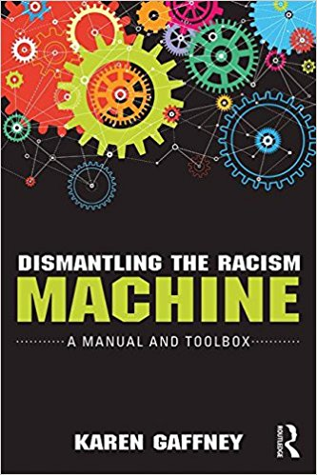
Change yourself: develop antiracist mindset (4/6)
Karen’s book goes into more depth about the 3 myths introduced in these workshops.
Includes reflection questions and recommended resources; last chapter focuses just on tools for action

Slide 11
Change yourself: develop antiracist mindset (5/6)
This website provides a list of “characteristics of white supremacy culture which show up in our organizations.” Read through this list, and identify the characteristics that you have encountered in your organizations and in yourself.
This activity can work well for group discussion.
White Supremacy Culture
Perfectionism
Sense of urgency
Defensiveness
Individualism
Either/or thinking
and more
http://www.cwsworkshop.org/PARC_site_B/dr-culture.html

Slide 12
Change yourself: develop antiracist mindset (6/6)
White Caucus
“A white caucus provides a space for white people to examine their own thoughts, feelings, and experiences of race, and to discover how they have been conditioned as white people.”
https://arrow-journal.org/going-to-the-root-how-white-caucuses-contribute-to-racial-justice/
This article gives a great overview of how a white caucus can provide white people with an opportunity to reflect on their whiteness without unintentionally causing harm to BIPOC during those conversations.
An effective white caucus will meet regularly and could use readings/film as a springboard to discussion.

Slide 13
Breakout Room Discussion #1
Change yourself: develop antiracist mindset
How can you build a practice of developing your antiracist mindset that is sustainable (so you don’t stop) and lifetime (because you’re never done learning)?
What challenges do you think you will encounter?
15 minutes; identify facilitator; briefly introduce yourself (name, town/state); focus time on discussing questions; facilitator will share highlights with full group after Breakouts; remember your Breakout Room #

Slide 14
Change the world: apply antiracist mindset
“As the mayor of Minneapolis from 2014 to 2018, as a Minneapolis City Council member from 2006 until 2014 and as a white Democrat, I can say this: White liberals, despite believing we are saying and doing the right things, have resisted the systemic changes our cities have needed for decades. We have mostly settled for illusions of change . . . These efforts make us feel better about racism, but fundamentally change little for the communities of color whose disadvantages often come from the hoarding of advantage by mostly white neighborhoods.”
--Betsy Hodges, “As Mayor of Minneapolis, I Saw How White Liberals Block Change”

Slide 15
Change the world: apply antiracist mindset
Listen to Bryan Stevenson’s recent interview on Ezra Klein’s show
Truth and Reconciliation
What would it look like if we told the truth about race and racism in the US?
https://podcasts.apple.com/us/podcast/bryan-stevenson-on-how-america-can-heal/id1081584611?i=1000485472204

Slide 16
Change the world: apply antiracist mindset (1/5)
Speak up when you hear the racial myths we’ve discussed being reinforced
  If it’s by a stranger on social media, think about how much emotional energy and time you want to spend engaging with a stranger who may not be swayed by you
  On the other hand, if it is someone you know, think about how you can engage in a conversation over time; be vulnerable and reveal how you came to be more open to antiracism; model your process for the other person; ask questions; avoid lecturing; share an article or link to a video and encourage follow-up discussion

Slide 17
Change the world: apply antiracist mindset (1/5)
Speak up when you hear the racial myths we’ve discussed being reinforced
  If you see/hear these myths being reinforced by a business, speak up, share your concerns via social media and encourage boycott if concern is not addressed
  If you see/hear these myths being reinforced by customers of local businesses, ask the business to respond, and if they refuse see above

Slide 18
Change the world: apply antiracist mindset (2/5)
Support the activism of an existing antiracist organization working to end systemic racism
  Black Lives Matter
  Movement for Black Lives (coalition of groups)
  NJ Institute for Social Justice

Slide 19

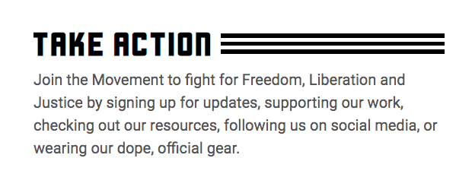
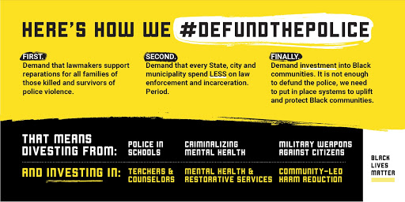
Change the world: apply antiracist mindset
https://blacklivesmatter.com/

Slide 20
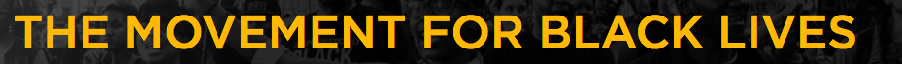
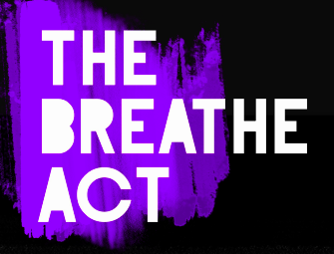
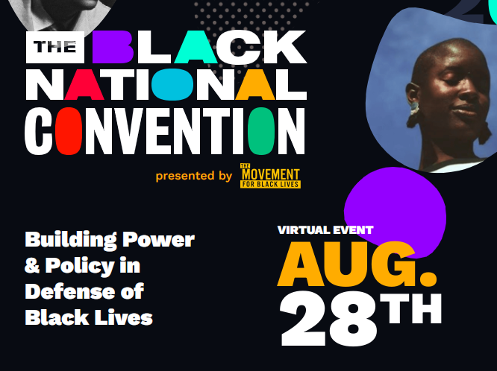
Change the world: apply antiracist mindset
https://m4bl.org/
https://breatheact.org/

Slide 21
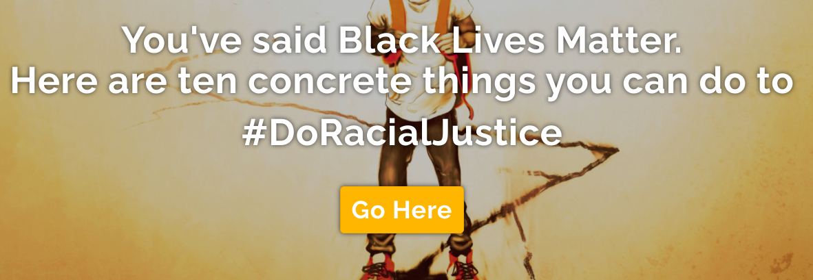
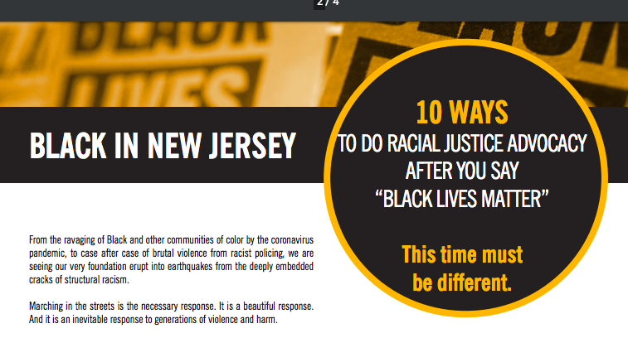
Change the world: apply antiracist mindset
NJ Institute for Social Justice
https://www.njisj.org/
https://www.njisj.org/10-things

Slide 22
Change the world: apply antiracist mindset (3/5)
Focus on 1 system that you have a connection to (workplace, community, etc.)
  Policing
  Education
  Healthcare
  Housing
  Voting
What organizations are already addressing systemic racism in that area?
What other people are connected to that same system/workplace who can you partner with?
How can you strengthen your influence inside that system? (run for school board; become involved in local politics) Or from outside that system? (direct action; protests)

Slide 23
Change the world: apply antiracist mindset (4/5)
Shift from ally to accomplice
“it is absolutely too late for you to be an ally. At this moment in history, as we move to abolish racism, it calls for you to either be an accomplice or completely get out of the way....When white people come to the realization that their personal investment in their own humanity is on the line, white people will begin knowing what to do in this work. . . . Please take the words of Lila Watson to heart: ‘If you have come to help me, you are wasting your time, but if you have come because your liberation is bound up in mine, then let us work together.’”
--Rev. Dr. Stephany Rose Spaulding, “White Folks: It’s Too Late for 'Allies’”

Slide 24
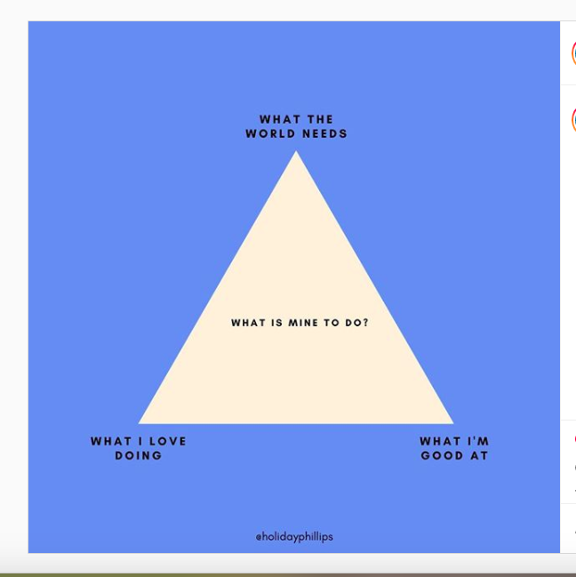
Change the world: apply antiracist mindset (5/5)
holidayphillips
https://www.instagram.com/p/CClUsTclKuA/?igshid=1nw75noxe5fto

Slide 25
Breakout Room Discussion #2
Change the world: apply antiracist mindset
How can you build a practice of applying your antiracist mindset to address systemic racism through action and activism?
What challenges do you think you will encounter?
15 minutes; same groups and same facilitator; focus time on discussing questions; facilitator will share highlights with full group after Breakouts

