Slide 1

Dismantling the Racism Machine:
Week 2 a lecture series sponsored by the Summit Free Public Library
Dr. Karen Gaffney
English Department
Raritan Valley Community College
Branchburg, NJ
Website: dividednolonger.com
Email: dividednolonger@gmail.com
Twitter: @dividednolonger
Pronouns: she/her/hers

Slide 2
Lecture Series Schedule
Fridays July 17 - August 7 myths taught to white people that need to be debunked in order to challenge systemic racism
Week 1 - What does it mean to say that race is a social construct and not biological, and why does it matter?
Week 2 - How did the invention of race serve to divide and conquer people in colonial America, and what impact does this continue to have?
Week 3 - How and why has systemic racism persisted after the civil rights movement?
Week 4 - How can white people best challenge systemic racism today?

Slide 3
Terminology (based on a question last week)
People from historically marginalized groups should be able to determine how they want to be identified
Sometimes terms are top-down and are imposed on a group. Sometimes terms emerge from the grassroots.
Terms are fluid and constantly shifting to address the moment
“Person/People of Color” (POC) became popular after Civil Rights Movement
“BIPOC” (Black, Indigenous, People of Color) has been used more recently rather than simply POC in order to explicitly name the historical oppression of Black and Indigenous peoples in the US
Black can be used instead of African American for various reasons, including that African American doesn’t include Black immigrants from Africa or Caribbean
  Last month Associated Press: capitalize Black when describing a person

Slide 4
Terminology (based on a question last week)
“Latinx” is a recent term that seeks to disrupt the gender binary of Latino (male) and Latina (female); some criticize “Hispanic” for being a top down government label
“Asian American” became popular during the Civil Rights Movement to express pan-Asian solidarity
“Indigenous” is most current term; “Native American” and “Indian” are still common, sometimes varying depending on region of the US
“Minority” can be seen as dehumanizing
Some white people in the US distance themselves from their whiteness by identifying as their European ethnic heritage – I have concerns about that because does it really disrupt white supremacy or just excuse the white person from acknowledging their complicity in white supremacy?

Slide 5
Racial Myths or Ideologies
Ideology = myth or belief people are unknowingly indoctrinated into believing
  power
Racial myths or ideologies are false & dangerous
  obscure the Racism Machine

Slide 6
Last week
Myth #1: Human races are biologically different (or, race is biological)
  false & dangerous
If you missed our session last week or you need a refresher, please watch the video recording on my website
  https://dividednolonger.com/dismantling-the-racism-machine-a-lecture-series-sponsored-by-summit-library/
  My website also includes links to recommended sources

Slide 7

If we chip away at the false and dangerous myth that race is biological and recognize the reality that race is a human invention, then the Racism Machine is more visible.
We ask: Who built it? When? Why? How?

Slide 8
Reality
Myth #2: Race has always existed. Whiteness has always existed.
Race is an invention, a relatively recent human invention. One location:
Colonial Virginia, 1600s
The line between servant and enslaved person was ambiguous
People didn’t identify as “Black” or “white” (nationality, language, religion)
Skin color wasn’t main dividing line
Elite wealthy landowners vs. labor
Bacon’s Rebellion (1676)

Slide 9
Race is an invention
Race was invented to protect the elite and divide and conquer the masses through the creation of a racial hierarchy
1705: “slave codes” of Virginia positioned enslaved Black people at bottom of hierarchy as “real estate” (permanent slavery that meant enslaved people were considered property) while European servants, newly called “white” received specific benefits of food, money, and a weapon when they finished their temporary servitude

Slide 10
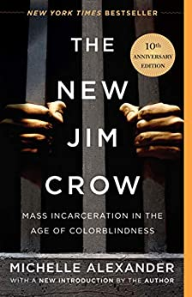
Race is an invention
Legal scholar Michelle Alexander, in The New Jim Crow, refers to whiteness as a “racial bribe,” in which European laborers were “bribed” with new idea of whiteness to turn against enslaved Black people
“Deliberately and strategically, the planter class extended special privileges to poor whites in an effort to drive a wedge between them and black slaves. White settlers were allowed greater access to Native American lands, white servants were allowed to police slaves through slave patrols and militias, and barriers were created so that free labor would not be placed in competition with slave labor. These measures effectively eliminated the risk of future alliances between black slaves and poor whites. . . . Their own plight had not improved much, but at least they were not slaves” (Alexander 25).

Slide 11
Racial categories were constructed
White: built with benefits and attached to freedom, connected to civilization, humanity, and a newly blended European identity
Black: built by removing rights and chained to chattel slavery and the status of “property” with a blending of distinct African nationalities and cultures
Native: built by blending distinct indigenous nations into one group often seen as savage and without national identity, with limited or no rights, especially not to the land

Slide 12
Why does it matter if we recognize that race is a social construct, a human invention?
If we don’t recognize that race is constructed, then we see racial categories and a racial hierarchy as natural, as inherent, as biological, as a given. We don’t question them – we take them for granted.
In other words, we normalize them – we see them as normal
If we normalize these racial categories and a racial hierarchy, then take for granted that what emerges is the only way of doing things...

Slide 13
Ideology of white supremacy became normalized
Myth that race has always existed, especially that whiteness has always existed, became embedded in an ideology of white supremacy that took for granted a racial hierarchy (rather than recognize that racial categories and racial hierarchy were constructed)
Ideology of white supremacy was built into the creation of this nation and normalized through every system (law, housing, finance, education, media, etc.)
Laws and government policies carried out this ideology
  US Constitution includes 10 protections for slavery
  1790: Citizenship for whites only
  1808: Even though Congress banned the international slave trade, the number of enslaved people drastically increased through the rise in the domestic slave trade
  1830: Indian Removal Act, followed by the Trail of Tears

Slide 14
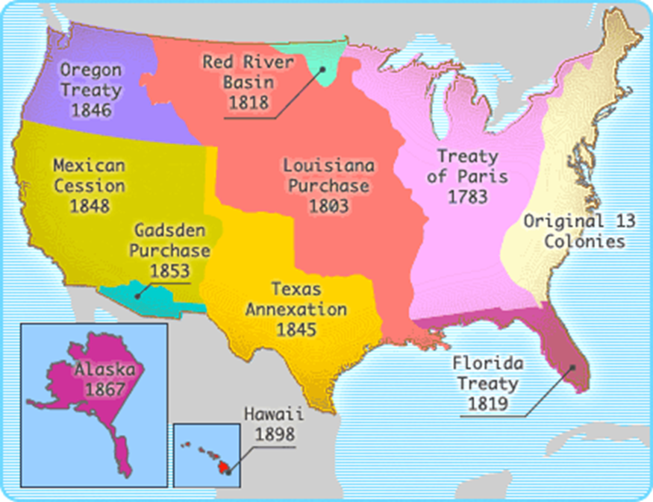
Stolen Land

Slide 15
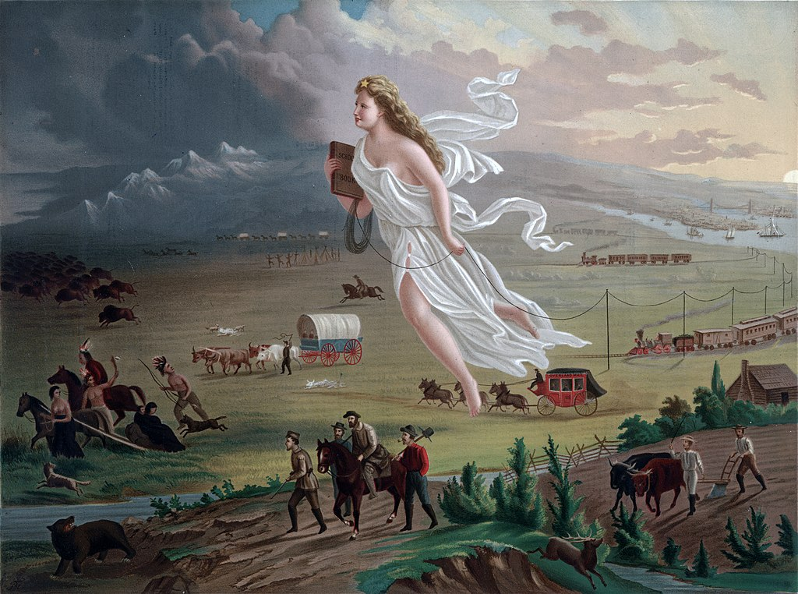
Manifest Destiny
American Progress (1872) by John Gast

Slide 16
Laws and government policies continued to carry out the ideology of white supremacy
US waged war on Mexico to acquire more land (1846-1848)
  Land wasn’t empty – it came with people who were treated as 2nd class
After the Civil War ended in 1865: “slavery by another name” (sharecropping, lynching, “Black codes,” & criminalization of Black people through convict leasing) (film 13th)
1882: Chinese Exclusion Act (“Yellow Peril”)

Slide 17
Laws and government policies continued to carry out the ideology of white supremacy
Late 1800s-early 1900s: Native American Boarding Schools to “kill the Indian, save the man” (motto of Carlisle, PA school principal Col. Richard Henry Pratt)
1896: Plessy v. Ferguson (“separate but equal” Jim Crow segregation upheld by Supreme Court)
Eugenics movement for white racial purity was mainstream in American science, politics, & culture
  1924: Racial Integrity Act (ban on interracial marriage)
  1924: Immigration Act (immigration restricted to northern Europe)
  Influenced Nazi Germany

Slide 18
Who is white?
The History of White People by Nell Irvin Painter
“first enlargement of American whiteness”
  first half of 1800s: end of property qualifications for voting
  “virtually all male Europeans and their free male children could be naturalized and vote as white”
“second enlargement of American whiteness”
  late 1800s and early 1900s
  “Irish, Germans, and other ‘Nordics’ gained greater acceptance” as white
“third enlargement of American whiteness”
  1940s and 1950s
  Included southern Europeans and eastern Europeans
If whiteness can be “enlarged” then that means it is not natural -- it is socially constructed--but that was not acknowledged and instead whiteness was seen as always having existed; whiteness was taken for granted as a natural, biological identity

Slide 19
When courts decide who is not white
1878: California federal district court: a Chinese man could not become a citizen because he wasn’t white
1922: Supreme Court: a Japanese man could not be a citizen because he wasn’t white
1923: Supreme Court: a man from India could not become a citizen because he wasn’t white

Slide 20
Why does it matter who is and is not “white”?
Throughout American history, being “white” meant access to unearned advantages
  1700s & 1800s: freedom from slavery and access to stolen, indigenous land
  1900s: access to government benefits (Social Security, low-interest housing loans, GI Bill) and suburban segregated housing
Creation of inter-generational family wealth
  Whiteness is a “racial bribe” (Michelle Alexander)
  Whiteness pays a “public and psychological wage” (W.E.B. DuBois, Black Reconstruction in America)

Slide 21
Invented racial categories used to divide and conquer, maintain power structure
After 1676 Bacon’s Rebellion in Virginia:
  “whiteness defined through European ancestry was a calculated racial solution developed by colonial leaders to the economic and physical threat of laboring-class solidarity” (Goodman et al., Race: Are We So Different 44)
This type of divide and conquer strategy has continued ever since as a way for those in power to keep their power, for systemic racism to continue, and for status quo to persist

Slide 22
Invented racial categories used to divide and conquer, maintain power structure
Next week we’ll focus more specifically on how systemic racism continued after Civil Rights Movement of 1960s
For now: divide and conquer stereotypes deployed during and after the Civil Rights Movement of the 1960s to break interracial coalitions and to maintain the status quo

Slide 23
Invented racial categories used to divide and conquer, maintain power structure
“model minority” stereotype of Asian Americans
  “At a time when Americans are awash in worry over the plight of racial minorities—One such minority, the nation’s 300,000 Chinese Americans, is winning wealth and respect by dint of its own hard work” (US News & World Report, 12/26/1966)
  created categories of “good minority” and “bad minority” to show that racism is no longer a problem and if you work hard, you’ll be successful (no need for further civil rights protests; no need for government aid)

Slide 24
Invented racial categories used to divide and conquer, maintain power structure
African Americans stereotyped as:
  “welfare queens” (myth of “welfare fraud” leads to cuts to social services)
  “dangerous criminals” (myth of disproportionate drug use and drug selling leads to mass incarceration and War on Drugs)
Latinx people stereotyped as “illegal” and “not American”
Muslims stereotyped as “terrorists”
Rise in anti-Semitism

Slide 25
Develop an Antiracist Perspective
Last week and this week, we focused on 2 primary myths that white people in particular are indoctrinated into that uphold white supremacy
  Myth that race is biological
  Myth that race has always existed (myth that race is not a construct)
If we believe these myths, we see them as normal and take them for granted, so we don’t question the laws, policies, court decisions, culture, actions, and behaviors that result - we see them as the only way of doing things
However, if we start to recognize these myths as myths, we can start to reflect on how we’ve been indoctrinated into them, how to un-indoctrinate ourselves, and how to take action (which we’ll discuss in the 4th week of this series)

Slide 26
Breakout Rooms
After we come back from our break, you will automatically be placed in a Breakout Room for 15 minutes with about 5 people.
Purpose of the Breakout Room is to discuss:
  What can you do to develop a daily practice starting tomorrow of:
    catching yourself slipping into the myth that race has always existed
    recognizing that is a myth and instead see race is actually a construct/invention
    consciously pull yourself out of this myth?
  What questions do you want to ask Karen?

Slide 27
Directions for Breakout Rooms
Inside the Breakout Rooms:
  Keep track of your Breakout Room number
  When you get into the Breakout Room, open up the Chat so you can see the directions I’ll be sending out to everyone in a moment (move your cursor to bottom of screen to click on Chat)
  Identify facilitator
  Introduce yourselves very briefly
  Focus your time on discussing the question
  Identify any questions you want to ask Karen
When we finish the Breakout Rooms and come back together, Karen will call out one Breakout Room number at a time (so that’s why you need to remember your number), and each facilitator should share one brief highlight of the discussion about the question and share any questions the group has for Karen

