Slide 1

Dismantling the Racism Machine:
A Beginning Workshop Series for White People
Part 2
Dr. Karen Gaffney
English Department
Raritan Valley Community College
Branchburg, NJ
Website: dividednolonger.com
Email: dividednolonger@gmail.com
Twitter: @dividednolonger
Pronouns: she/her/hers

Slide 2
Workshop Series Schedule
Session 1: Wednesday, July 15, 7-8:30pm
  What racial myths do white people believe that we need to unlearn? This session will focus on how to debunk the myths that race is biological and that race (especially whiteness) has always existed. We will explore how these myths influence systemic racism today.
Session 2: Wednesday, July 22, 7-8:30pm
  How and why has systemic racism persisted after the civil rights movement? This session will focus on specific ways in which systemic racism has been adapted for a post-civil rights era, leading up to our present moment.
Session 3: Wednesday, July 29, 7-8:30pm
  How can white people challenge systemic racism today? This session will focus on how we can apply the concepts from Sessions 1 and 2 to create a sustained, lifelong practice of antiracism.
Optional check-in: Wednesday, August 19, 7-8:30pm

Slide 3
Last week
Myth #1: Human races are biologically different (or, race is biological)
Myth #2: Race has always existed. Whiteness has always existed.

Slide 4
How does the myth that race is biological persist today?
Healthcare
“Pain relief in US emergency rooms is related to patients’ race”
British Medical Journal, 1/15/2000
“I Don’t Feel Your Pain: A failure of empathy perpetuates racial disparities”
Slate, 6/27/2013
“Racial Disparities in Pain Management of Children With Appendicitis in Emergency Departments”
JAMA Pediatrics (Journal of the American Medical Association), 11/2015
“Black Mothers Keep Dying After Giving Birth”
NPR, 12/7/2017
“When race matters: disagreement in pain perception between patients and their physicians in primary care”
Journal of the National Medical Association, 1999
“Doctors Don’t Always Believe You When You’re a Black Woman”
Vice, 2/2/2018

Slide 5
How does the myth that race is biological persist today?
Education
“The Essence of Innocence: Consequences of Dehumanizing Black Children”
Journal of Personality and Social Psychology, 2/24/2014
“Racism in the Kindergarten Classroom: New research finds faces of five-year-old black boys put whites in a more threat-conscious state of mind”
Pacific Standard, 2/2/2016
“Why Won’t Society Let Black Girls Be Children?”
New York Times, 4/17/2020

Slide 6
How does the myth that race is biological persist today?
Policing
“People See Black Men as Larger, More Threatening Than Same-Sized White Men”
American Psychological Association, 3/3/2017
“Researchers studied nearly 100 million traffic stops and found black motorists are more likely to be pulled over”
CNN, 3/21/2019
“There's one epidemic we may never find a vaccine for: fear of black men in public spaces”
CNN, 5/27/2020
“US police kill up to 6 times more black people than white people”
New Scientist, 6/24/2020

Slide 7
If race is not biological, then it’s an invention – a social construct
“whiteness defined through European ancestry was a calculated racial solution developed by colonial leaders to the economic and physical threat of laboring-class solidarity” (Goodman et al., Race: Are We So Different 44)

Slide 8
Racial categories were constructed
White: built with benefits and attached to freedom, connected to civilization, humanity, and a newly blended European identity
Black: built by removing rights and chained to chattel slavery and the status of “property” with a blending of distinct African nationalities and cultures
Native: built by blending distinct indigenous nations into one group often seen as savage and without national identity, with limited or no rights, especially not to the land

Slide 9
Who is white?
The History of White People by Nell Irvin Painter
“first enlargement of American whiteness”
  first half of 1800s: end of property qualifications for voting
  “virtually all male Europeans and their free male children could be naturalized and vote as white”
“second enlargement of American whiteness”
  late 1800s and early 1900s
  “Irish, Germans, and other ‘Nordics’ gained greater acceptance” as white
“third enlargement of American whiteness”
  1940s and 1950s
  Included southern Europeans and eastern Europeans

Slide 10
Why does it matter who is and is not “white”?
Throughout American history, being “white” meant access to unearned advantages
  1700s & 1800s: freedom from slavery and access to stolen, indigenous land
  1900s: access to government benefits (Social Security, low-interest housing loans, GI Bill) and suburban segregated housing
Creation of inter-generational family wealth
  Whiteness is a “racial bribe” (Michelle Alexander)
  Whiteness pays a “public and psychological wage” (W.E.B. DuBois, Black Reconstruction in America)

Slide 11
Today
Myth #3: Racism occurred in the past, but that problem has been resolved
Reality
Systemic racism is a serious problem in the US today.
“Slavery is over.”
“The civil rights movement ended racism.”
“We elected a black President, so racism must be over.”

Slide 12
Why has systemic racism persisted after the Civil Rights Movement?
Why would we even ask such a question?
After all, the Civil Rights Movement of 1950s and 1960s accomplished so much:
Montgomery Bus Boycott and lunch counter sit-ins
Brown v. Board of Education (1954): “separate but equal” school segregation is unconstitutional
Civil Rights Act (1964)
Voting Rights Act (1965)
Immigration and Nationality Act (1965)
Fair Housing Act (1968)
institutions & facilities cannot say “whites only”

Slide 13
5 decades after Civil Rights Movement, where are we?
Yes, the Civil Rights Movement created massive cultural and legal changes
Yes, we elected a black President
But systemic racism persists today at significant and even worsening levels
  housing segregation
  school segregation
  maternal and infant mortality
What is the evidence for the persistence of systemic racism?

Slide 14
Housing segregation
“Segregation's Legacy: Fifty years after the Fair Housing Act was signed, America is nearly as segregated as when President Lyndon Johnson signed the law” (US News & World Report, 2018)
“Poor whites live in richer neighborhoods than middle-class blacks and Latinos” (Washington Post, 2015)

Slide 15
School segregation
Racial school segregation has worsened significantly since the 1980s
  number of schools with almost all white children has increased
  number of schools with almost all children of color has increased (see Brown at 62).
  2013 report from Rutgers: NJ has “apartheid” and “hyper-segregated” levels of school segregation

Slide 16
Maternal mortality
“More women die in the US from pregnancy-related complications than in any other developed country. . . . Racial disparities in maternal mortality are staggering -- black women are three to four times more likely to die from a pregnancy-related complication than non-Hispanic white women” (American College of Obstetricians and Gynecologists)

Slide 17
Infant Mortality
“White, educated American women lose their infants at rates similar to mothers in America’s peer countries…. Across the United States, black infants die at a rate that’s more than twice as high as that of white infants.” (Carpenter, The Nation, 2/15/2017)

Slide 18
What other systems reveal persistence of systemic racism today?
“Are Emily and Greg More Employable Than Lakisha and
Jamal?: White names receive 50 percent more callbacks for interviews.”
American Economic Review, 9/2004
“Why COVID-19 Disproportionately Impacts Latino Communities”
NPR, 7/1/2020
“Native Americans Feel Invisible In U.S. Health Care System”
NPR, 12/12/2017
“"The black-white economic divide is as wide as it was in 1968"”
Washington Post, 6/4/2020
“Why Won’t Hollywood Cast Asian Actors?”
New York Times, 4/22/2016

Slide 19
What other systems reveal persistence of systemic racism today?
“Race Best Predicts Whether You Live Near Pollution: Environmental racism extends far beyond Flint”
Nation, 2/18/2016
“African-Americans With College Degrees Are Twice As Likely to Be Unemployed as Other Graduates”
Atlantic, 5/27/2014
“As Coronavirus Spreads, So Does Xenophobia and Anti-Asian Racism”
Time, 3/6/2020
“Normalizing Injustice: The Dangerous Misrepresentations that Define Television’s Scripted Crime Genre” (Report, Color of Change, 2020)
“Latinos Onscreen, Conspicuously Few”
New York Times, 6/18/2014

Slide 20
Why has systemic racism persisted after the Civil Rights Movement?
The systemic racism embedded in our institutions and structures before the Civil Rights Movement continued afterwards. Legal scholar Derrick Bell describes the Supreme Court under the leadership of Chief Justice Earl Warren in the 1950s and 60s:
  “the civil rights decisions of the Warren Court were profoundly conservative and protected the economic and political status quo by responding to the pleas for justice by blacks and other severely disadvantaged groups just enough to siphon off discontent, thereby limiting the chances that the existing social order would pay more than minimal costs for the reforms achieved” (61)
  “We have made progress in everything yet nothing has changed” (22).

Slide 21
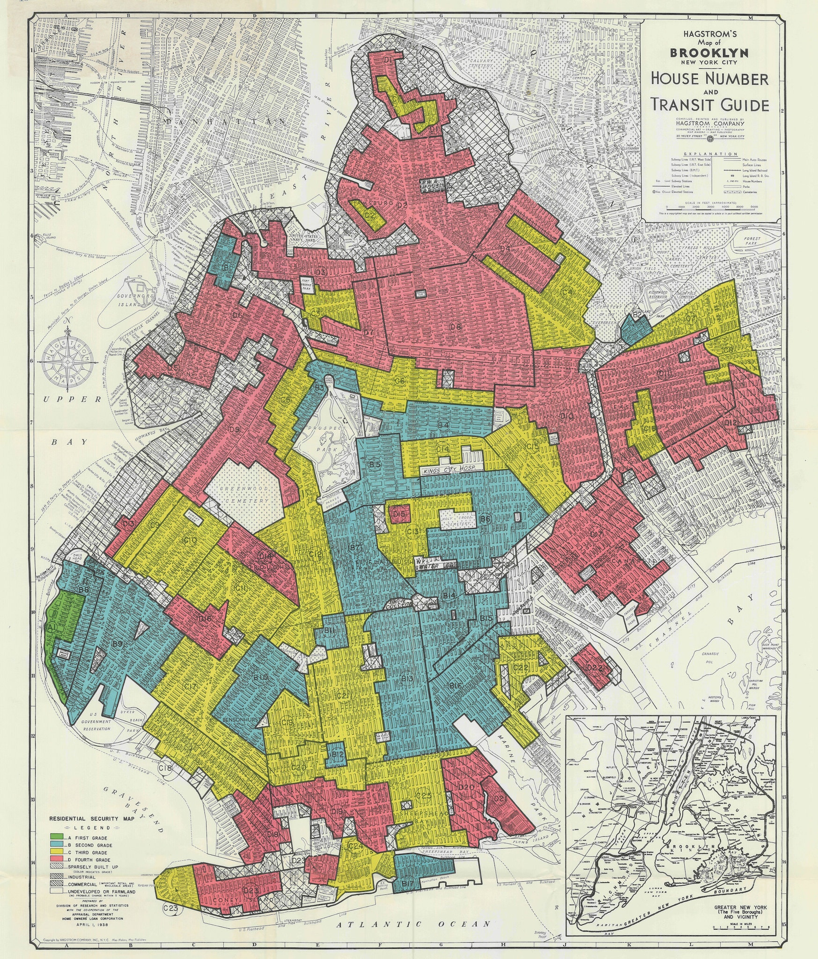
Racial Segregation Racial Wealth Gap
Redlining Brooklyn, 1938
Post-World War II Suburbs
“The tenant agrees not to permit the premises to be used or occupied by any person other than members of the Caucasian race, but the employment and maintenance of other than Caucasian domestic servants shall be permitted.” —Levittown Corporation Lease (1948)

Slide 22
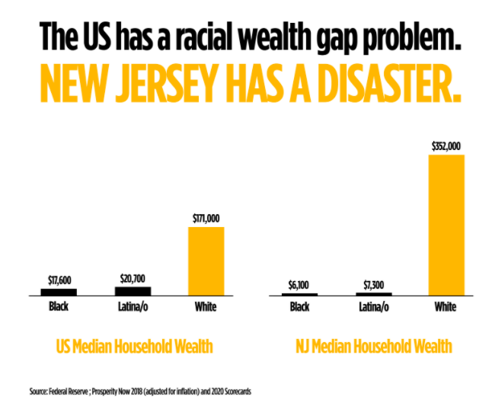
Racial Wealth Gap
NJ Institute for Social Justice

Slide 23
Why has systemic racism persisted after the Civil Rights Movement?
The systemic racism embedded in our institutions and structures before the Civil Rights Movement continued afterwards.
New ways of maintaining systemic racism developed in the backlash to the Civil Rights Movement
  COINTELPRO (FBI’s Counter-Intelligence Program under Director Edgar J. Hoover )
    conducted surveillance, infiltration, and intimidation on a variety of civil rights groups and group leaders in order to break apart burgeoning, increasingly powerful interracial alliances and to discredit leaders in the 1960s
  Supreme Court decided if a law has racially discriminatory impact but no documented intent to discriminate, it is constitutional (1976) and similarly racially biased sentencing is constitutional if there is no documented intent to discriminate (1987)
  Divide and conquer stereotypes deployed to break interracial coalitions and to maintain the status quo (parallel to Virginia colonial elite’s response to Bacon’s Rebellion of 1676)

Slide 24
Divide and Conquer stereotypes
“model minority” stereotype of Asian Americans
  “At a time when Americans are awash in worry over the plight of racial minorities—One such minority, the nation’s 300,000 Chinese Americans, is winning wealth and respect by dint of its own hard work” (US News & World Report, 12/26/1966)
  created categories of “good minority” and “bad minority” to show that racism is no longer a problem and if you work hard, you’ll be successful (no need for further civil rights protests; no need for government aid)
African Americans stereotyped as:
  “welfare queens” (myth of “welfare fraud” leads to cuts to social services)
  “dangerous criminals” (myth of disproportionate drug use and drug selling leads to mass incarceration and War on Drugs)

Slide 25
Divide and Conquer stereotypes maintain status quo of systemic racism
“model minority” stereotype of Asian Americans
African Americans stereotyped as “welfare queens” and “dangerous criminals”
Latinx people stereotyped as “illegal” and “not American”
Muslims stereotyped as “terrorists”
Rise in anti-Semitism

Slide 26
Why has systemic racism persisted after the Civil Rights Movement?
The systemic racism embedded in our institutions and structures before the Civil Rights Movement continued afterwards.
New ways of maintaining systemic racism developed in the backlash to the Civil Rights Movement

Slide 27
Why has systemic racism persisted after the Civil Rights Movement?
Additional factors that protect the status quo of systemic racism
  When the “whites only” sign of Jim Crow segregation came down (because of 1964 Civil Rights Act) but not much else about the structure changed, the superficial veneer of equality made it harder to point to the persistent racism
  Most people would say that being “a racist” is bad at the same time as they don’t believe they are racist at the same time as they uphold racism
  Rise in “law and order” rhetoric (rise in spending on policing)
  Racialized groups are targeted by being associated with mythical fraud and then legislative and court changes represent mythical fraud as actual fraud (welfare fraud, immigration fraud, voter fraud)
  White fear of white people becoming a statistical minority is stoked
    Rise of Alt-Right

Slide 28
Why has systemic racism persisted after the Civil Rights Movement?
Additional factors that protect the status quo of systemic racism
  Rise of neoliberalism
    increased focus on the individual rather than the collective
    shift to privatization
    growing gap between rich and poor
    stagnant wages for average worker
    rise of executive pay/compensation
    decrease in unions
    rise in corporate power due to de-regulation
    rise in corporate influence in politics
    cuts to spending for education, healthcare, social services and other aspects of public good (now seen as individual responsibility)

Slide 29
Breakout Room Discussion
Last week and this week, we focused on 3 primary myths that white people are indoctrinated into that uphold white supremacy
  Myth that race is biological
  Myth that race has always existed
  Myth that systemic racism is no longer a problem
Next week we’ll shift to action, so now, we’ll focus on building an antiracist mindset that involves these daily activities:
  Catch myself slipping into one of the above myths and consciously pull myself out of that myth
  Recognize the ways in which the systems that I interact with perpetuate systemic racism
Breakout Room Question: How will you follow through on the above 2 daily activities starting tomorrow? What concerns/questions do you have about this work?

