Slide 1

Dismantling the Racism Machine:
Week 1 a lecture series sponsored by the Summit Free Public Library
Dr. Karen Gaffney
English Department
Raritan Valley Community College
Branchburg, NJ
Website: dividednolonger.com
Email: dividednolonger@gmail.com
Twitter: @dividednolonger
Pronouns: she/her/hers

Slide 2
Lecture Series Schedule
Fridays July 17 - August 7
Week 1 - What does it mean to say that race is a social construct and not biological, and why does it matter?
Week 2 - How did the invention of race serve to divide and conquer people in colonial America, and what impact does this continue to have?
Week 3 - How and why has systemic racism persisted after the civil rights movement?
Week 4 - How can white people best challenge systemic racism today?

Slide 3
Racial Myths or Ideologies
Ideology = myth or belief people are unknowingly indoctrinated into believing
  power
Racial myths or ideologies are false & dangerous
  obscure the Racism Machine

Slide 4
Myth #1: Human races are biologically different
We might think that 2 random white people are closer biologically to each other than a random white person and Black person…
This belief is false

Slide 5
Race is not biological but a human invention

Slide 6
Myth #1: Human races are biologically different
Reality: There are no inherent or biological or genetic differences between groups we call races because race is a social construct (a human invention).
Human DNA is about 99.9% identical throughout the world
No scientific, biological, or genetic way to separate humans into “races”
Human beings are one of the most genetically similar of all species

Slide 7
But what about skin color?
Yes, skin color varies, and there are genes that influence skin color
But skin color varies gradually along a spectrum: where would you draw the line between “races”?

Slide 8
But what about skin color??
Furthermore genes that influence skin color do NOT correlate with the majority of other traits (like intelligence, athleticism, criminality, and perseverance)
Skin color variation is a relatively recent trait that reflects where one’s ancestors settled in relation to the equator
We have been taught to focus on skin color as a sign that there are biologically distinct human racial groups, but that’s a myth

Slide 9
What’s next
The website for this Lecture Series includes sources that provide more info about explaining how the myth that race is biological is false
For now, I want to move on to the question: Why is the myth race is biological dangerous?

Slide 10
Why is the myth that race is biological dangerous?
Serves as rationale and justification for white supremacy, anti-blackness, imperialism, colonialism, genocide, land theft, slavery, segregation, and more
  Establishes belief that white people are only people who are civilized; the “superiority” of white people is seen as natural, inherent, and unchangeable (as biological)
Core myth at heart of American history and American systems: law, government, healthcare, education, culture, and more
Belief in this myth has been increasing recently (see Angela Saini’s book Superior: The Return of Race Science)
Let’s consider a throughline from past to present in order to understand the danger of this myth
  in the 1700s and 1800s, belief in this myth was mainstream in science, culture, and politics
  kept white elites in power

Slide 11
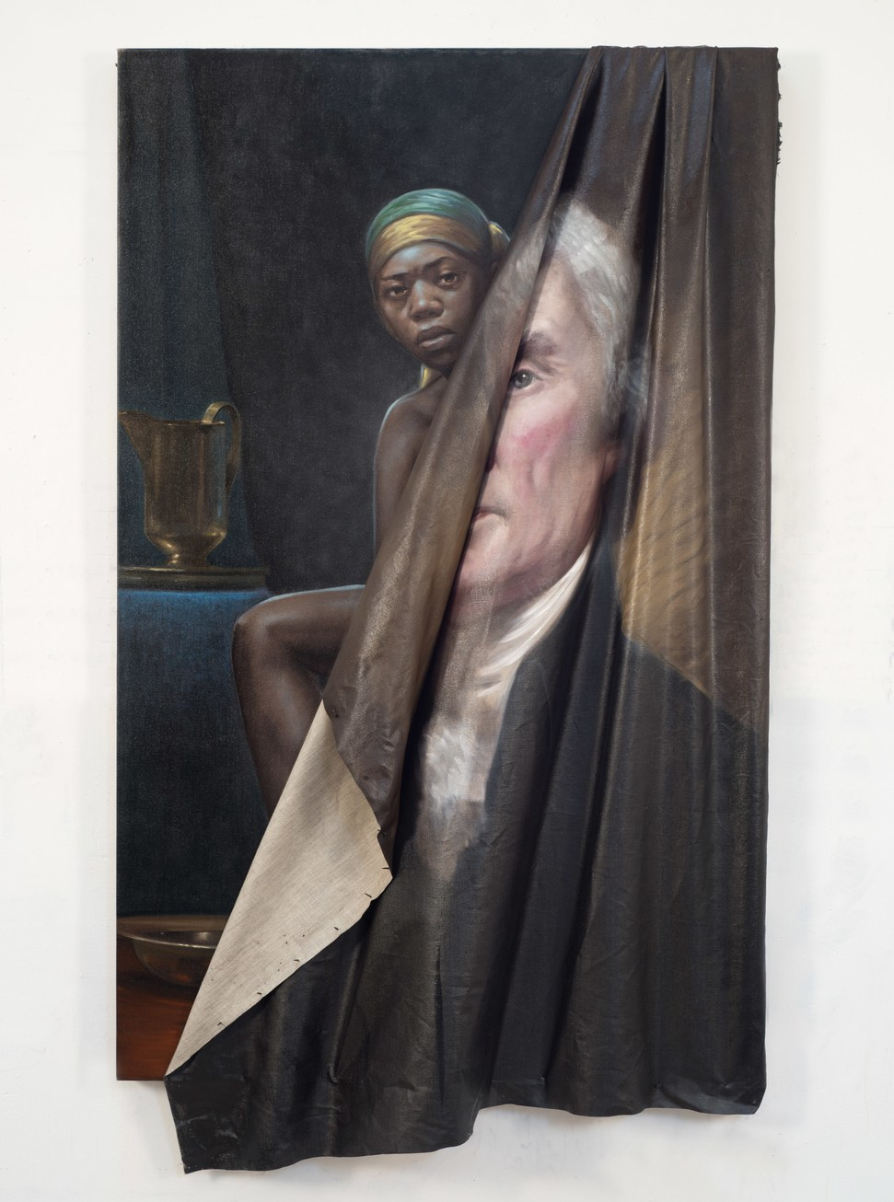
Thomas Jefferson
only published book, Notes on the State of Virginia (1788), was considered one of the most important books of early America
this book helps lay the foundation for the myth that race is biological
“the blacks, whether originally a distinct race, or made distinct by time and circumstances, are inferior to the whites in the endowments both of body and mind” (153)
Beyond the Myth of Benevolence (2014) by Titus Kaphar

Slide 12

John C. Calhoun
Vice President (under John Quincy Adams & Andrew Jackson)
In an 1837 speech while he was Senator:
“I hold that in the present state of civilization, where two races of different origin, and distinguished by color, and other physical differences, as well as intellectual, are brought together, the relation now existing in the slaveholding States between the two, is, instead of an evil, a good–a positive good.”
Statue of John C. Calhoun removed by city council, Charleston, SC, 6/24/20

Slide 13
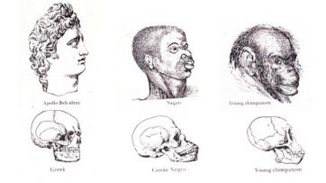
Myth #1: Human races are biologically different
Josiah Nott, Types of Mankind, 1854
White people are biologically superior
  “To them have been assigned, in all ages, the largest brains and the most powerful intellect; theirs is the mission of extending and perfecting civilization” (67)

Slide 14
Myth #1: Human races are biologically different
Josiah Nott, Types of Mankind, 1854
Indigenous people are biologically inferior
    “In America, the aboriginal barbarous tribes cannot be forced to change their habits. . . . It is as clear as the sun at noon-day, that in a few generations more the last of these . . . men will be numbered with the dead. . . . a civilized full-blooded Indian does not exist among them.” (69)

Slide 15
Myth #1: Human races are biologically different
Josiah Nott
Black people are biologically inferior
  “In Africa, owing to their natural improvidence . . . [they] are, more frequently than not, a half-starved, and therefore half-developed race” (Types of Mankind 260) (1854)
  he “achieves his greatest perfection, physical and moral, and also greatest longevity, in a state of slavery” (“Statistics of Southern Slave Population…” 281) (1847)

Slide 16
Eugenics Movement
(late 1800s and early 1900s)
Eugenics movement for white racial purity was mainstream in American science, politics, & culture
American eugenics influenced Nazi Germany
Goals of American eugenics movement:
  prevent someone deemed “fit” from marrying someone
  deemed “unfit”
    1924: Racial Integrity Act (ban on interracial marriage)
      1967: Supreme Court decision Loving v. Virginia stated that such bans are unconstitutional

Slide 17
Eugenics Movement
(late 1800s and early 1900s)
  2. prevent those deemed “unfit” from immigrating into the US
    1921: soon-to-be Vice President (and later President) Calvin Coolidge: “Biological laws tell us that certain divergent people will not mix or blend. The Nordics [Northern Europeans] propagate themselves successfully. With other races, the outcome shows deterioration on both sides” (Good Housekeeping)
    1924: Immigration Act (immigration restricted to northern Europe)
      1965: Immigration and Nationality Act ended those restrictions

Slide 18
Eugenics Movement
(late 1800s and early 1900s)
  3. prevent people deemed “unfit” from reproducing
    1927: Supreme Court decision Buck v. Bell that involuntary sterilization of those labelled “feeble-minded” was constitutional
      Since 2000, several states have officially apologized for their state programs of involuntary sterilization and established funds to compensate victims

Slide 19
Why is the myth that race is biological dangerous?
This myth determines:
Who is considered fully human?
Who can own property?
Who is considered a rightful land owner?
Who can be a citizen?
Who is innocent?
Who has the power to control?
Who is an individual?
Who has a history?
Who feels pain?
Who is considered property?
Whose land is considered empty, unoccupied, & available?
Who cannot be a citizen?
Who is a threat?
Who needs to be controlled?
Who is a stereotype?
Who doesn’t have a history?
Who does not feel pain?
vs

Slide 20
Shifting to the present
2000: completion of the first map of the human genome
2010s: rise in belief that race is biological
Pres. Bill Clinton: “I believe one of the great truths to emerge from this triumphant expedition inside the human genome is that in genetic terms all human beings, regardless of race, are more than 99.9 percent the same.”
Dr. J. Craig Venter: “the concept of race has no genetic or scientific basis.”
2012: scholar Peter A. Chow-White: the myth that race is biological “has not only been raised once again, but given new currency” (94)
2019: Superior: The Return of Race Science by Angela Saini: “Scientific racism has come out of the shadows, at least partly because wider society has made room for it” (104)

Slide 21
PAUSE and REFLECT
What is on your mind after hearing about this myth?
How do you think the myth that race is biological persists today? Consider what you personally experience and observe at work, in your community, etc. Consider what you see in the news, social media, etc.
What questions do you have so far about anything I’ve shared?
Keep your ideas in mind or jotted down so you can share them during the discussion

Slide 22
How does the myth that race is biological persist today?
Healthcare
“Pain relief in US emergency rooms is related to patients’ race”
British Medical Journal, 1/15/2000
“I Don’t Feel Your Pain: A failure of empathy perpetuates racial disparities”
Slate, 6/27/2013
“Racial Disparities in Pain Management of Children With Appendicitis in Emergency Departments”
JAMA Pediatrics (Journal of the American Medical Association), 11/2015
“Black Mothers Keep Dying After Giving Birth”
NPR, 12/7/2017
“When race matters: disagreement in pain perception between patients and their physicians in primary care”
Journal of the National Medical Association, 1999
“Doctors Don’t Always Believe You When You’re a Black Woman”
Vice, 2/2/2018

Slide 23
How does the myth that race is biological persist today?
Healthcare
from The Washington Post, “The disturbing reason some African American patients may be undertreated for pain” (4/4/16)
“Researchers at the University of Virginia quizzed white medical students and residents to see how many believed inaccurate and at times ‘fantastical’ differences about the two races -- for example, that blacks have less sensitive nerve endings than whites or that black people's blood coagulates more quickly. They found that fully half thought at least one of the false statements presented was possibly, probably or definitely true. Moreover, those who held false beliefs often rated black patients’ pain as lower than that of white patients and made less appropriate recommendations about how they should be treated.”

Slide 24
How does the myth that race is biological persist today?
Education
“The Essence of Innocence: Consequences of Dehumanizing Black Children”
Journal of Personality and Social Psychology, 2/24/2014
“Racism in the Kindergarten Classroom: New research finds faces of five-year-old black boys put whites in a more threat-conscious state of mind”
Pacific Standard, 2/2/2016
“Why Won’t Society Let Black Girls Be Children?”
New York Times, 4/17/2020

Slide 25
How does the myth that race is biological persist today?
Education
Both Black girls and Black boys are perceived as being older than they really are, with harmful consequences
Despite comparable behavior between Black and white students, “Black students are suspended or expelled three times more frequently than white students” (Justice Policy Institute)

Slide 26
How does the myth that race is biological persist today?
Policing
“People See Black Men as Larger, More Threatening Than Same-Sized White Men”
American Psychological Association, 3/3/2017
“Researchers studied nearly 100 million traffic stops and found black motorists are more likely to be pulled over”
CNN, 3/21/2019
“There's one epidemic we may never find a vaccine for: fear of black men in public spaces”
CNN, 5/27/2020
“US police kill up to 6 times more black people than white people”
New Scientist, 6/24/2020

Slide 27
How does the myth that race is biological persist today?
Policing
From the grand jury testimony of white officer Darren Wilson describing his shooting of unarmed Black teenager Michael Brown in Ferguson, Missouri on August 9, 2014
“‘And when I grabbed him, the only way I can describe it is I felt like a 5-year-old holding onto Hulk Hogan. . . . [Michael Brown] had the most intense aggressive face. The only way I can describe it, it looks like a demon, that’s how angry he looked’”
https://www.npr.org/sections/thetwo-way/2014/11/25/366519644/ferguson-docs-officer-darren-wilsons-testimony

Slide 28
Legal scholar Dorothy Roberts
Fatal Invention: How Science, Politics, and Big Business Re-create Race in the Twenty-first Century (2012):
“Like citizenship, race is a political system that governs people by sorting them into social groupings based on invented biological demarcations. Race is not only interpreted according to invented rules, but, more important, race itself is an invented political grouping. Race is not a biological category that is politically charged. It is a political category that has been disguised as a biological one” (Roberts 4)

Slide 29
Challenges
If you are white and grew up in the US, you were almost certainly indoctrinated into or conditioned to believe the myth that race is biological because it is in the air we breathe, reinforced by every system
  Reflecting on your indoctrination is important
This myth fuels the persistence of systemic racism today because it rationalizes an ideology of white supremacy and anti-blackness
Most K-12 schools in the US don’t debunk this myth, and usually the college courses that debunk it are electives
White people are usually not taught to question this myth, so they are unaware of unearned advantages that they have, so they resist the idea of white privilege (this resistance is known as “white fragility”)
Or if white people do question this myth, they have trouble finding other white people to discuss this with

Slide 30
Transition to discussion
After a 10-minute break, we will begin discussion, and I’ll start by asking you a question:
  How do you see the myth that race is biological operating in your life (at your workplace, community, family, etc.)?
With so many people together here, not everyone will be able to share, but it’d be great to hear from several people, so please try to keep your response brief. Move your cursor to the bottom of your screen and click on Participants. That will open a new box to the right, and you’ll see the “Raise Hand” button – click on that to indicate you’d like to speak. When your name is called, unmute yourself.
After several people have had a chance to share, we can shift into open Q&A, where people can ask questions using “Raise Hand” or by typing questions into the Chat.
Please avoid lengthy commentary in the Chat.
You can use the “Reaction” button at the bottom of Zoom to share your support by “clapping” or “thumbs up.”

