Slide 1

Dismantling the Racism Machine:
A Beginning Workshop Series for White People
Part 1
Dr. Karen Gaffney
English Department
Raritan Valley Community College
Branchburg, NJ
Website: dividednolonger.com
Email: dividednolonger@gmail.com
Twitter: @dividednolonger
Pronouns: she/her/hers

Slide 2
Workshop Series Schedule
Session 1: Wednesday, July 15, 7-8:30pm
  What racial myths do white people believe that we need to unlearn? This session will focus on how to debunk the myths that race is biological and that race (especially whiteness) has always existed. We will explore how these myths influence systemic racism today.
Session 2: Wednesday, July 22, 7-8:30pm
  How and why has systemic racism persisted after the civil rights movement? This session will focus on specific ways in which systemic racism has been adapted for a post-civil rights era, leading up to our present moment.
Session 3: Wednesday, July 29, 7-8:30pm
  How can white people challenge systemic racism today? This session will focus on how we can apply the concepts from Sessions 1 and 2 to create a sustained, lifelong practice of antiracism.
Optional check-in: Wednesday, August 19, 7-8:30pm

Slide 3
Racial Myths or Ideologies
Ideology = myth or belief people are unknowingly indoctrinated into believing
  power
Racial myths or ideologies are false & dangerous
  obscure the Racism Machine

Slide 4
Myth #1: Human races are biologically different
We might think that 2 random white people are closer biologically to each other than a random white person and Black person…
This belief is false

Slide 5
Race is not biological but a human invention

Slide 6
Myth #1: Human races are biologically different
Reality: There are no inherent or biological or genetic differences between groups we call races because race is a social construct (a human invention).
Human DNA is about 99.9% identical throughout the world
No scientific, biological, or genetic way to separate humans into “races”
Human beings are one of the most genetically similar of all species

Slide 7
But what about skin color?
Yes, skin color varies, and there are genes that influence skin color
But skin color varies gradually along a spectrum: where would you draw the line between “races”?

Slide 8
But what about skin color??
Furthermore genes that influence skin color do NOT correlate with the majority of other traits (like intelligence, athleticism, criminality, and perseverance)
Skin color variation is a relatively recent trait that reflects where one’s ancestors settled in relation to the equator
We have been taught to focus on skin color as a sign that there are biologically distinct human racial groups, but that’s a myth

Slide 9
What’s next
The website for this Workshop Series includes sources that provide more info about explaining how the myth that race is biological is false
For now, I want to move on to the question: Why is the myth race is biological dangerous?

Slide 10
Why is the myth that race is biological dangerous?
Serves as rationale and justification for white supremacy, imperialism, colonialism, genocide, land theft, slavery, segregation, and more
  Establishes belief that white people are only people who are civilized; the “superiority” of white people is seen as natural, inherent, and unchangeable (as biological)
Core myth at heart of American history and American systems: law, government, healthcare, education, culture, and more
Belief in this myth has been increasing recently (see Angela Saini’s book Superior: The Return of Race Science)
Let’s consider a throughline from past to present in order to understand the danger of this myth
  in the 1700s and 1800s, belief in this myth was mainstream in science, culture, and politics
  kept white elites in power

Slide 11
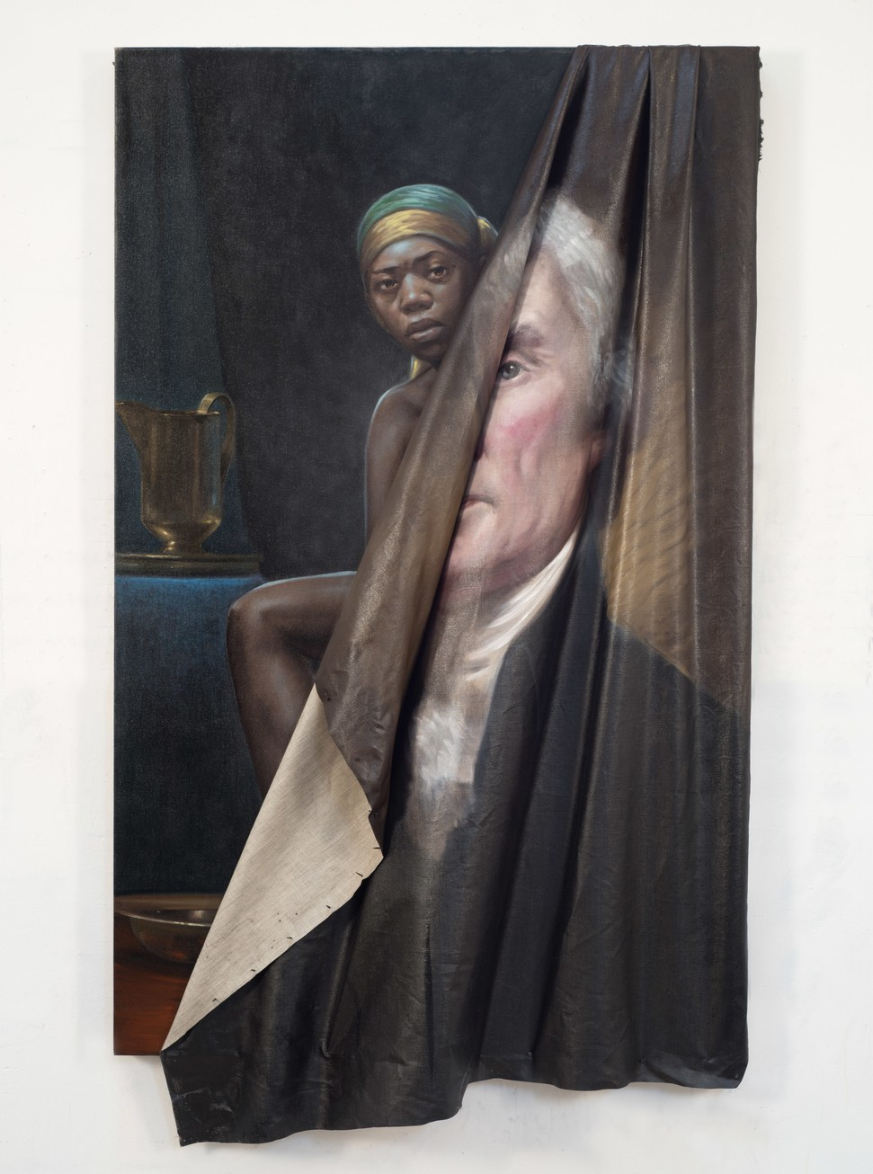
Thomas Jefferson
only published book, Notes on the State of Virginia (1788), was considered one of the most important books of early America
this book helps lay the foundation for the myth that race is biological
“the blacks, whether originally a distinct race, or made distinct by time and circumstances, are inferior to the whites in the endowments both of body and mind” (153)
Beyond the Myth of Benevolence (2014) by Titus Kaphar

Slide 12

John C. Calhoun
Vice President (under John Quincy Adams & Andrew Jackson)
In an 1837 speech while he was Senator:
“I hold that in the present state of civilization, where two races of different origin, and distinguished by color, and other physical differences, as well as intellectual, are brought together, the relation now existing in the slaveholding States between the two, is, instead of an evil, a good–a positive good.”
Statue of John C. Calhoun removed by city council, Charleston, SC, 6/24/20

Slide 13
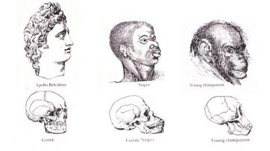
Myth #1: Human races are biologically different
Josiah Nott, Types of Mankind, 1854
White people are biologically superior
  “To them have been assigned, in all ages, the largest brains and the most powerful intellect; theirs is the mission of extending and perfecting civilization” (67)

Slide 14
Myth #1: Human races are biologically different
Josiah Nott, Types of Mankind, 1854
Indigenous people are biologically inferior
    “In America, the aboriginal barbarous tribes cannot be forced to change their habits. . . . It is as clear as the sun at noon-day, that in a few generations more the last of these . . . men will be numbered with the dead. . . . a civilized full-blooded Indian does not exist among them.” (69)

Slide 15
Myth #1: Human races are biologically different
Josiah Nott
Black people are biologically inferior
  “In Africa, owing to their natural improvidence . . . [they] are, more frequently than not, a half-starved, and therefore half-developed race” (Types of Mankind 260) (1854)
  he “achieves his greatest perfection, physical and moral, and also greatest longevity, in a state of slavery” (“Statistics of Southern Slave Population…” 281) (1847)

Slide 16
Why is the myth that race is biological dangerous?
This myth determines:
Who is considered fully human?
Who can own property?
Who is considered a rightful land owner?
Who can be a citizen?
Who is innocent?
Who has the power to control?
Who is an individual?
Who has a history?
Who feels pain?
Who is considered property?
Whose land is considered empty, unoccupied, & available?
Who cannot be a citizen?
Who is a threat?
Who needs to be controlled?
Who is a stereotype?
Who doesn’t have a history?
Who does not feel pain?
vs

Slide 17
PAUSE and REFLECT for 3 minutes
Take a moment to write down (for yourself, not to share yet):
    What is on your mind after hearing about this myth?
    How does the myth that race is biological persist today? Consider what you personally experience and observe at work, in your community, etc. Consider what you see in the news, social media, etc.
    What questions do you have so far about anything I’ve shared?

Slide 18
How does the myth that race is biological persist today?
Policing
From the grand jury testimony of white officer Darren Wilson describing his shooting of unarmed Black teenager Michael Brown in Ferguson, Missouri on August 9, 2014
“‘And when I grabbed him, the only way I can describe it is I felt like a 5-year-old holding onto Hulk Hogan. . . . [Michael Brown] had the most intense aggressive face. The only way I can describe it, it looks like a demon, that’s how angry he looked’”
https://www.npr.org/sections/thetwo-way/2014/11/25/366519644/ferguson-docs-officer-darren-wilsons-testimony

Slide 19
How does the myth that race is biological persist today?
Education
Both Black girls and Black boys are perceived as being older than they really are, with harmful consequences
Despite comparable behavior between Black and white students, “Black students are suspended or expelled three times more frequently than white students.” (Justice Policy Institute)
Article: “Racism in the Kindergarten Classroom: New research finds faces of five-year-old black boys put whites in a more threat-conscious state of mind”
Article: “Why Won’t Society Let Black Girls Be Children?”
  “from 2013-2014, only 20 percent of female preschoolers were black, but black girls made up 54 percent of female preschool children with one or more suspensions”

Slide 20
How does the myth that race is biological persist today?
Healthcare
from The Washington Post, “The disturbing reason some African American patients may be undertreated for pain” (4/4/16)
“Researchers at the University of Virginia quizzed white medical students and residents to see how many believed inaccurate and at times ‘fantastical’ differences about the two races -- for example, that blacks have less sensitive nerve endings than whites or that black people's blood coagulates more quickly. They found that fully half thought at least one of the false statements presented was possibly, probably or definitely true. Moreover, those who held false beliefs often rated black patients’ pain as lower than that of white patients and made less appropriate recommendations about how they should be treated.”

Slide 21
PAUSE and REFLECT for 3 minutes
Take a moment to revisit what you wrote a few minutes ago
    What do you want to add to what you already wrote?
Then I’ll briefly go through the 2nd myth, and we’ll shift into discussion

Slide 22

If we chip away at the false and dangerous myth that race is biological and recognize the reality that race is a human invention, then the Racism Machine is more visible.
We ask: Who built it? When? Why? How?

Slide 23
Reality
Myth #2: Race has always existed. Whiteness has always existed.
Race is an invention, a relatively recent human invention. One location:
Colonial Virginia, 1600s
The line between servant and enslaved person was ambiguous
People didn’t identify as “Black” or “white” (nationality, language, religion)
Skin color wasn’t main dividing line
Elite wealthy landowners vs. labor
Bacon’s Rebellion (1676)

Slide 24
Race is an invention
Race was invented to protect the elite and divide and conquer the masses through the creation of a racial hierarchy
1705: “slave codes” of Virginia positioned enslaved Black people at bottom of hierarchy as “real estate” (permanent slavery that meant enslaved people were considered property) while European servants, newly called “white” received specific benefits of food, money, and a weapon when they finished their temporary servitude

Slide 25
Race is an invention
Legal scholar Michelle Alexander, in The New Jim Crow, refers to the invention of whiteness as the creation of a “racial bribe,” in which European laborers were “bribed” with new idea of whiteness to turn against enslaved Black people

Slide 26
Ideology of white supremacy
Myth that race has always existed, especially that whiteness has always existed, became embedded in an ideology of white supremacy
Ideology of white supremacy was built into the creation of this nation and normalized through every system (law, housing, finance, education, media, etc.)
Laws and government policies carried out this ideology
  US Constitution includes 10 protections for slavery
  1790: Citizenship for whites only
  1808: Even though Congress banned the international slave trade, the number of enslaved people drastically increased through the rise in the domestic slave trade
  1830: Indian Removal Act, followed by the Trail of Tears

Slide 27
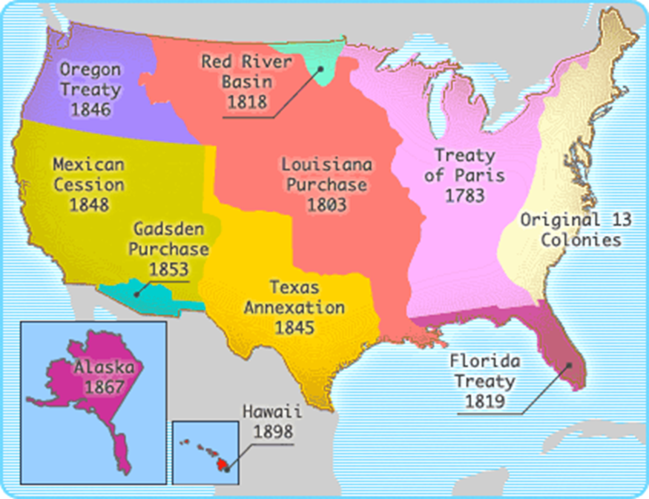
Stolen Land

Slide 28
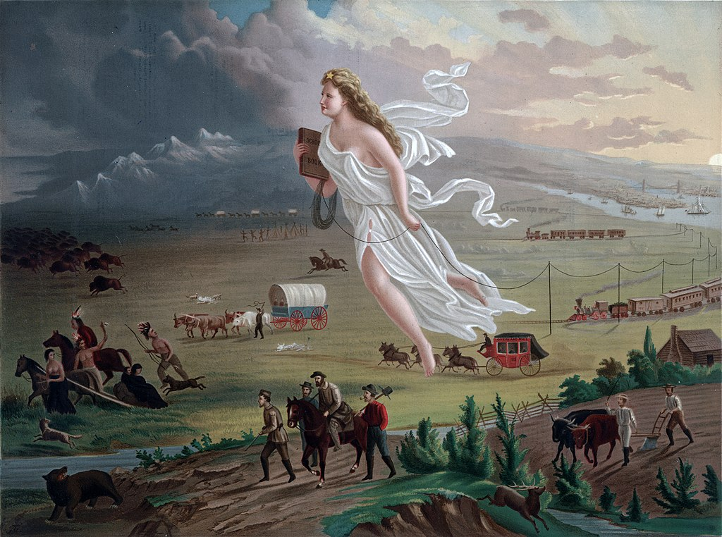
Manifest Destiny
American Progress (1872) by John Gast

Slide 29
Laws and government policies continued to carry out the ideology of white supremacy
After the Civil War ended in 1865: “slavery by another name” (sharecropping, lynching, “Black codes,” & criminalization of Black people through convict leasing) (film 13th)
1882: Chinese Exclusion Act (“Yellow Peril”)
1896: Plessy v. Ferguson (“separate but equal” Jim Crow segregation upheld by Supreme Court)
Eugenics movement for white racial purity was mainstream in American science, politics, & culture
  1924: Racial Integrity Act (ban on interracial marriage)
  1924: Immigration Act (immigration restricted to northern Europe)
  Influenced Nazi Germany

Slide 30
Shifting to the present
2000: completion of the first map of the human genome
2010s: rise in belief that race is biological
Pres. Bill Clinton: “I believe one of the great truths to emerge from this triumphant expedition inside the human genome is that in genetic terms all human beings, regardless of race, are more than 99.9 percent the same.”
Dr. J. Craig Venter: “the concept of race has no genetic or scientific basis.”
2012: scholar Peter A. Chow-White: the myth that race is biological “has not only been raised once again, but given new currency” (94)
2019: Superior: The Return of Race Science by Angela Saini: “Scientific racism has come out of the shadows, at least partly because wider society has made room for it” (104)

Slide 31
Challenges
If you are white and grew up in the US, you were almost certainly indoctrinated into or conditioned to believe the 2 myths discussed (that race is biological & that race has always existed) because they are in the air we breathe, reinforced by every system
  Reflecting on your indoctrination is important
These myths fuel the persistence of systemic racism today because they rationalize an ideology of white supremacy
Most K-12 schools in the US don’t debunk these myths, and usually the college courses that debunk them are electives
White people are usually not taught to question these myths so they are unaware of unearned advantages that they have, so they resist the idea of white privilege (this resistance is known as “white fragility”)
Or if white people do question these myths, they have trouble finding other white people to discuss this with

Slide 32
Transition to discussion
Go back to the writing you’ve been doing tonight, review it, and respond to one or both questions:
  How were you indoctrinated into one of these myths (that race is biological, that race has always existed)?
  How do you see one or both of these myths operating in your life (at your workplace, community, etc.)?
In a moment, I will stop sharing these slides and pose these 2 questions again. Think about which question you’d like to share. Again, we won’t have time to hear from everyone, but it’d be great hear from several people, so please try to keep your response brief. Then we’ll transition to open Q&A and a short poll.

