Slide 1
Why don’t we talk about whiteness?
What is it?
Why does it matter?
Dr. Karen Gaffney
English Department
Raritan Valley Community College
Website & Blog: dividednolonger.com
Email: Karen.Gaffney@raritanval.edu
Twitter: @dividednolonger
Pronouns: she/her/hers

Slide 2
Today’s plan
I’ll highlight a few key ideas and explain them briefly
Please save your questions – there will be plenty of time for Q&A
Please take a postcard with info about my book and my website that includes lots of resources, including this PowerPoint

Slide 3

Who am I?
English Professor at RVCC for 16 years
  English Composition I w Workshop
  English Composition II
  Race in American Literature and Popular Culture
Author of Dismantling the Racism Machine: A Manual and Toolbox
White anti-racist educator
  Facilitate workshops in local
  communities and at national
  conferences

Slide 4
Where I begin
There is a massive gap between what scholars who study race and racism take for granted and what public (especially white public) knows
As a white anti-racist educator, one contribution I can make is to help bridge the gap
When I share basic concepts and history about race and racism, students and community members of all ages respond: “Why didn’t I learn this before?”

Slide 5
Why don’t we talk about whiteness?
White people are often taught:
  It’s not polite to talk about race
  Or if you do talk about race, it’s appropriate to say “I don’t see race” or “I’m colorblind”
  It’s better if I say nothing about race rather than talk about it for fear of saying the wrong thing
  Race is something other people have who aren’t white
  White people are individuals not a group
Given that, it’s no surprise that talking about whiteness can make white people uncomfortable

Slide 6
What is whiteness?
We’re often taught to believe that whiteness and race more generally are biological, meaning that human beings can be divided into biologically distinct racial groups.
However, that is simply not true.
For decades, scholars in the sciences, social sciences, and humanities have consistently explained that race is not biological but rather a social construct
  Created by society
  Human invention

Slide 7
Race is not biological but a human invention

Slide 8
Race is not biological but a human invention
We might think that 2 random white people
are closer biologically to each other than a random white person and black person…
But that is simply not true because race is not biological but a human invention

Slide 9
Race is not biological but a human invention
Human DNA is about 99.9% identical throughout the world
Human beings are one of the most genetically similar of all species
We are more genetically similar to each other than penguins are to each other or fruit flies are to each other
No scientific, biological, or genetic way to separate humans into “races”

Slide 10
But what about skin color??
Yes, skin color varies, and there are genes that influence skin color
But skin color varies gradually along a spectrum: where would you draw the line between “races”?
Furthermore genes that influence skin color do NOT correlate with the majority of other traits (Goodman et al. 97)
We have been taught to focus on skin color as a sign that there are biologically distinct human racial groups, but that is a myth
“Skin color really is only skin deep. Most traits are inherited independently from one another. . . . Knowing one trait, like skin color, doesn’t necessarily tell you anything else about a person’s other traits.”
  -PBS documentary Race: The Power of an Illusion, “10 Things Everyone Should Know About Race”

Slide 11
If race is a human invention, then who invented it? When? Why? How?
We might think that race has always existed, but the concept has only been around for a few centuries
For example: colonial Virginia, 1600s
  The line between servant and slave was ambiguous
  People didn’t identify as “black” or “white” (nationality, language, religion)
    People from Europe were not “white” – they were English, Scottish, French, etc.
  Skin color was not a dividing line
  Elite wealthy landowners vs. labor
Bacon’s Rebellion (1676): people we would call black and people we would call white rebelled against the elite

Slide 12
Bacon’s Rebellion (1676)
Legal scholar Michelle Alexander (author of The New Jim Crow): “The events in Jamestown were alarming to the planter elite, who were deeply fearful of the multiracial alliance of bond workers and slaves. Word of Bacon’s Rebellion spread far and wide, and several more uprisings of a similar type followed” (24)

Slide 13
The Construction of the
Racism Machine: “White”
1691: first time “white” is used in colonial Virginia law
  the children of white women and black or Native American men are identified as “abominable mixture and spurious issue”; interracial marriage is banned and such couples are “banished” (Hening, vol. 3 86-87)
1705: the Virginia law that establishes black slaves as permanent slaves, as “real estate” (property) also establishes that white servants receive benefits of food, money, and weapons when their period of indentured servitude is over; they can go to court if not treated well

Slide 14
Why whiteness?
“whiteness defined through European ancestry was a calculated racial solution developed by colonial leaders to the economic and physical threat of laboring-class solidarity” (Goodman et al. 44).
Michelle Alexander refers to this strategy as a “racial bribe,” in which white laborers were given a bribe, whiteness, in order to turn against black slaves (25):
“Deliberately and strategically, the planter class extended special privileges to poor whites in an effort to drive a wedge between them and black slaves. White settlers were allowed greater access to Native American lands, white servants were allowed to police slaves through slave patrols and militias, and barriers were created so that free labor would not be placed in competition with slave labor. These measures effectively eliminated the risk of future alliances between black slaves and poor whites. . . . Their own plight had not improved much, but at least they were not slaves” (25).

Slide 15
Why whiteness?
As whiteness was constructed, white people came to be seen as the only people who were fully human
If white people were the only people seen as fully human, as naturally superior, then a society based on white supremacy could be seen as natural, as the way it’s supposed to be, as something to be taken for granted
This belief in white superiority becomes a powerful ideology, a belief taken for granted as the truth, when actually whiteness is an invention to divide and conquer the masses and protect the power of the elite

Slide 16
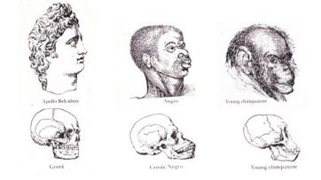
Whiteness in the new nation
Naturalization Act of 1790: citizenship to “free white persons”
Late 1700s and 1800s: scientists and politicians said and wrote that white people were biologically superior to black people, who were biologically closer to animals
Eugenics movement in the late 1800s - early 1900s was a mainstream US movement for white racial purity that prompted bans on interracial marriage, limits on immigration from everywhere except northern Europe, and involuntary sterilization; this work contributed to the Holocaust
Josiah Nott,
Types of Mankind, 1854

Slide 17
Who is white?
The History of White People by Nell Irvin Painter
“first enlargement of American whiteness”
  first half of 1800s: end of property qualifications for voting
  “virtually all male Europeans and their free male children could be naturalized and vote as white”
“second enlargement of American whiteness”
  late 1800s and early 1900s
  “Irish, Germans, and other ‘Nordics’ gained greater acceptance” as white
“third enlargement of American whiteness”
  1940s and 1950s
  Included southern Europeans and eastern Europeans

Slide 18
When courts decide who is not white
1878: California federal district court: a Chinese man could not become a citizen because he wasn’t white
1922: Supreme Court: a Japanese man could not be a citizen because he wasn’t white
1923: Supreme Court: a man from India could not become a citizen because he wasn’t white

Slide 19
Why does it matter who is and is not “white”?
Throughout American history, being “white” meant access to unearned advantages
  1700s & 1800s: freedom from slavery and access to stolen, indigenous land
  1900s: access to government benefits (Social Security, low-interest housing loans, GI Bill) and suburban segregated housing
Creation of inter-generational family wealth
Today: massive racial wealth gap

Slide 20
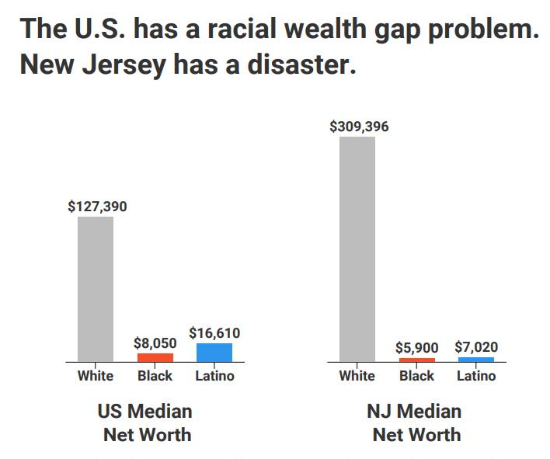
Racial Wealth Gap
NJ Institute for Social Justice (2018 data)
(from report “Reclaiming the American Dream” https://www.njisj.org/)

Slide 21
How does today’s US Census define “white”?

Slide 22
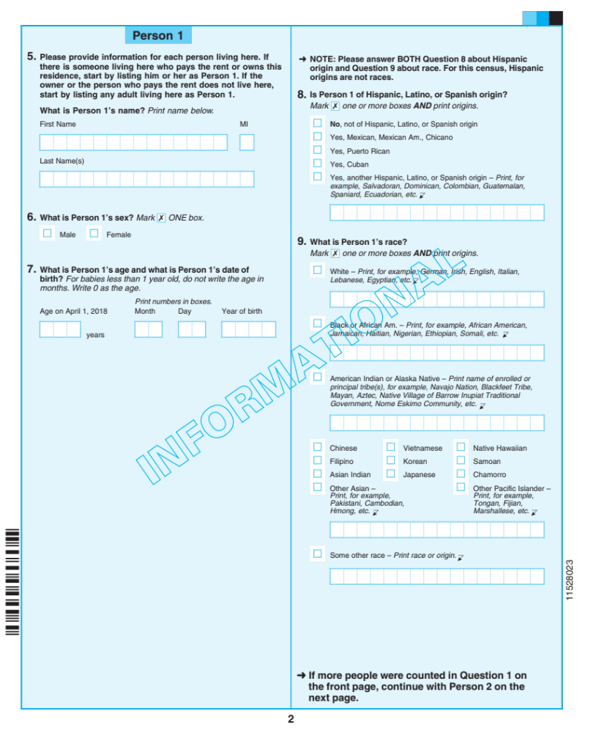
Proposed 2020
Census: “race”
US Census Bureau’s definition of “white” based on 1997 federal definitions available here: https://www.census.gov/topics/population/race/about.html
“White – A person having origins in any of the original peoples of Europe, the Middle East, or North Africa.”

Slide 23
Proposed 2020 Census: “Hispanic origin”

Slide 24
What now?
Recognize how people, especially white people, have been manipulated to believe pervasive false racial myths that are in the very air we breathe
  White people are often not aware of systemic, unearned advantages they have (white privilege) so they respond to idea of white privilege by saying they aren’t privileged and that they worked hard for what they have
  If white people are not aware of this history, raising awareness is an important step, and white people who are becoming aware should talk to other white people about what they’re learning

Slide 25
What about white guilt?
It’s not the fault of white people today that racism was created a few centuries ago
But we did inherit this system that we benefit from, even if we aren’t aware of it
We need to become aware and develop anti-racist perspective, which is active rather than passive
  How am I complicit in perpetuating racism?
Resist getting defensive about racism, what Robin DiAngelo calls “white fragility”
Focus on addressing systemic, institutional, structural racism

Slide 26
What next?
Organizations to follow & support:
NJ Institute for Social Justice
  https://www.njisj.org/
Color of Change
  https://colorofchange.org/
Resources:
Karen’s website: Divided No Longer
  https://dividednolonger.com/
  Includes this PowerPoint under My Presentations
  Includes links to articles, organizations, recommended books, etc.
Karen’s book: Dismantling the Racism Machine
  The book is an introductory step-by-step guide for understanding basic concepts of race and racism in the US
  last chapter is all action steps

Slide 27
Thank you!
Dismantling the Racism Machine: A Manual and Toolbox is available:
  routledge.com - 20% off in April
  Amazon
  Ask your local library and bookseller to stock it
My blog dividednolonger.com has this Powerpoint and many resources
Email me: Karen.Gaffney@raritanval.edu
Follow me on Twitter: @dividednolonger

