Slide 1

Dismantling the Racism Machine
Part 6
Dr. Karen Gaffney
English Department
Raritan Valley Community College
Branchburg, NJ
Website: dividednolonger.com
Email: dividednolonger@gmail.com
Twitter: @dividednolonger
Pronouns: she/her/hers

Slide 2
Resources on my website
My website = Divided No Longer: https://dividednolonger.com/
Check out the tabs at the top (or in a menu list depending on your browser), which include Resources on Race and Racism (which then includes sub-tabs on specific topics)
Also click on the tab “My Presentations” and scroll down to the Leisure Learning Series of Bernards Library and click on the link to this page: https://dividednolonger.com/lecture-series/
  I created this page for you to compile resources relevant for each week of this series, so please check it out
Feel free to email me with any feedback or questions
  Email: dividednolonger@gmail.com

Slide 3
How can my book help you?
This entire lecture series is based on my book, Dismantling the Racism Machine: A Manual and Toolbox (Routledge, 2018)
My book will help answer many of the questions you’ve raised
My book can help you with next steps:
  The last chapter (Step 5) is entirely action steps, specific actions you can take to address the problems of systemic racism being raised here
  Organize a book club reading & discussion of my book to raise awareness among your neighbors, community group members, church group members, etc.
  My book also serves as professional development for K-12 educators, so recommend it to teachers and school board members you know
  Recommend it to your network of family members, friends, former colleagues, and more
  If lack of awareness is one of our obstacles, use my book to help address that

Slide 4
Review: Whiteness
“whiteness defined through European ancestry was a calculated racial solution developed by colonial leaders to the economic and physical threat of laboring-class solidarity”
Part of this “calculation” of whiteness needed to include mechanisms for establishing the borders around whiteness (since it’s not real to begin with – it’s an invention) and for patrolling those borders
Last week – mechanism of the census

Slide 5
Today’s topic:
How and why has systemic racism persisted after the Civil Rights Movement?
Why would we even ask such a question?
After all, the Civil Rights Movement of 1950s and 1960s accomplished so much:
Montgomery Bus Boycott and lunch counter sit-ins
Brown v. Board of Education (1954): “separate but equal” school segregation is unconstitutional
Civil Rights Act (1964)
Voting Rights Act (1965)
Fair Housing Act (1968)
institutions & facilities cannot say “whites only”

Slide 6
5 decades after Civil Rights Movement, where are we?
Yes, the Civil Rights Movement created massive cultural and legal changes
Yes, we elected a black President
But the following systemic problems persist today at significant and even worsening levels
  housing segregation
  school segregation
  racial wealth gap
  maternal and infant mortality
How do we know these persist? Why?

Slide 7
School segregation
Racial school segregation has worsened significantly since the 1980s
  number of schools with almost all white children has increased
  number of schools with almost all children of color has increased
For example, UCLA reports that in 1988, almost 6% of public schools were more than 90% non-white, while in 2013, that tripled to 18% (Brown at 62).
2013 report from Rutgers: NJ has “apartheid” and “hyper-segregated” levels of school segregation

Slide 8
Housing segregation
“Segregation's Legacy: Fifty years after the Fair Housing Act was signed, America is nearly as segregated as when President Lyndon Johnson signed the law.” (US News & World Report, 2018)
“Poor whites live in richer neighborhoods than middle-class blacks and Latinos” (Washington Post, 2015)

Slide 9
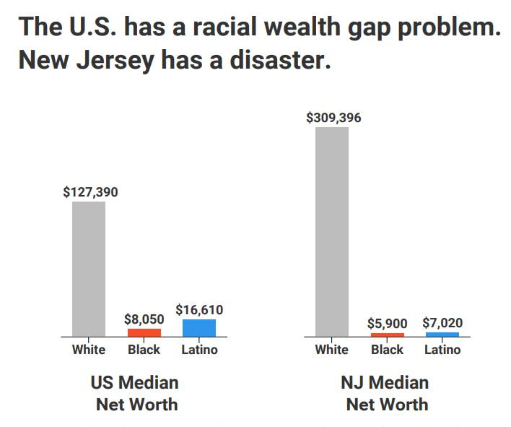
Racial Wealth Gap
NJ Institute for Social Justice (2018 data)
(from report “Reclaiming the American Dream” https://www.njisj.org/)

Slide 10
Maternal mortality
American College of Obstetricians and Gynecologists
“More women die in the US from pregnancy-related complications than in any other developed country. The US is the only industrialized nation with a rising maternal mortality rate, and between 2000 and 2014, there was a 26% increase in the maternal mortality rate. Racial disparities in maternal mortality are staggering -- black women are three to four times more likely to die from a pregnancy-related complication than non-Hispanic white women.”

Slide 11
Infant Mortality from The Nation, 2017
“White, educated American women lose their infants at rates similar to mothers in America’s peer countries…. Across the United States, black infants die at a rate that’s more than twice as high as that of white infants. The disparity is acute in a number of booming urban areas, from San Francisco—where black mothers are more than six times as likely to lose infants as white mothers—to Washington, DC. In the capital’s Ward 8, which is the poorest in the city and over 93 percent black, the infant-mortality rate is 10 times what it is in the affluent, predominantly white Ward 3.” (Carpenter)

Slide 12
Why has systemic racism persisted after the Civil Rights Movement?
Derrick Bell, legal scholar and Critical Race Theorist, describes the Supreme Court under the leadership of Chief Justice Earl Warren, who served from 1953 to 1969. We may think of this Court as ending racism through decisions like Brown v. Board of Education, which ruled in 1954 that racial segregation in schools was unconstitutional. However, Bell writes:
  “the civil rights decisions of the Warren Court were profoundly conservative and protected the economic and political status quo by responding to the pleas for justice by blacks and other severely disadvantaged groups just enough to siphon off discontent, thereby limiting the chances that the existing social order would pay more than minimal costs for the reforms achieved” (61)
  “We have made progress in everything yet nothing has changed” (22).

Slide 13
Why has systemic racism persisted after the Civil Rights Movement?
Massive backlash to the Civil Rights Movement that manifested in a variety of forms
  Next week: “divide and conquer” stereotypes that I touched upon during our first lecture
  COINTELPRO (FBI’s Counter-Intelligence Program)
    conducted surveillance, infiltration, and intimidation on a variety of civil rights groups and group leaders in order to break apart burgeoning, increasingly powerful interracial alliances and to discredit leaders

Slide 14
COINTELPRO (FBI’s Counter-Intelligence Program)
FBI Director Edgar J. Hoover mandated the agency use COINTELPRO to “expose, disrupt, misdirect, discredit, and otherwise neutralize” several civil rights organizations and leaders (qtd. in Taylor)
The COINTELPRO Papers: Documents from the FBI’s Secret Wars Against the Dissent in the United States, published in 1990, reproduces copies of many of these FBI internal memos, including: “forged letters to activists and their supporters, families, employers, landlords, college administrators and church superiors; FBI-authored articles and editorials which ‘cooperative news media’ ran as their own; cartoon leaflets that the FBI published in the name of certain radical groups in order to ridicule and antagonize others” (Churchill and Wall xi).

Slide 15
COINTELPRO (FBI’s Counter-Intelligence Program)
For example, one internal FBI memo states:
“These suggestions are to create factionalism between not only the national leaders but also local leaders, steps to neutralize all organizational efforts of the BPP [Black Panther Party] as well as create suspicion amongst the leaders as to each others sources of finances, suspicion concerning their respective spouses and suspicion as to who may be cooperating with law enforcement” (qtd in. Churchill and Wall 125)
The Black Panthers were trying to end police brutality and build community resources, like a free breakfast program for children.
Another internal FBI memo explicitly states the program’s purpose, “to help neutralize extremist Black Panthers and foster split between them and Student Nonviolent Coordinating Committee (SNCC)” (qtd. in Churchill and Wall 127)
COINTELPRO program served as one explicit example of a powerful divide and conquer strategy aimed at discrediting civil rights leaders and organizations and disrupting interracial coalitions.

Slide 16
Why has systemic racism persisted after the Civil Rights Movement?
Existing systemic racism was not effectively disrupted
  Redlining and segregated suburbs, segregated schools, and segregated lives
  Early-mid1900s: Red lines were drawn around neighborhoods deemed risky and undesirable, usually communities of color. Homebuyers of color were funneled to these areas, and they were charged much higher rates. This practice negatively affected intergenerational wealth for black families and serves as yet another contributor to today’s racial wealth gap.
  Segregated suburbs were built outside of cities; highways were also built to provide easy access from the suburb to the city, and many of these highways divided and even demolished urban communities of color
  Benefits of Social Security and GI Bill not readily available to African Americans

Slide 17
Why has systemic racism persisted after the Civil Rights Movement?
Existing systemic racism was not effectively disrupted
  Environmental racism
    Communities of color were and are much more likely to live closer to environmentally dangerous locations
Fundamental racial ideology that race is biological and hierarchical persists
  School to prison pipeline
    Children of color get more harshly disciplined for same behavior in school as white children
    Next week: more on criminalization of African Americans after civil rights movement through War on Drugs
  Medical racism
    African Americans are perceived as having a higher pain threshold than white people (Part 2 resources on my website)

Slide 18
Why has systemic racism persisted after the Civil Rights Movement?
Massive backlash to the Civil Rights Movement that manifested in a variety of forms
Creation of mythical “frauds” that target, demonize, and marginalize specific racialized groups
  “Welfare fraud”
  “Voter fraud”
  “immigration fraud”
Once the ideology that these “frauds” are real is perpetuated successfully, access to rights and opportunities are blocked or limited
Yes, the “whites only” sign of Jim Crow segregation came down. But what if not much else about an institution or system changed?

Slide 19
Questions? Comments?
Thanks to the Leisure Learning Program, sponsored by the Friends of the Bernards Township Library and the Bernards Township Library
Dismantling the Racism Machine: A Manual and Toolbox is available at routledge.com and Amazon
Visit my website dividednolonger.com for this Powerpoint and many resources, inc. a page for this series under My Presentations
Email me: dividednolonger@gmail.com

